Slide 1
Multi-dim Node-Specific Graph Neural Architecture Search for Distribution Shift
2252090 王麒懿, 2250420 陈君, 2250758 林继申
2025年6月20日

Slide 2

01
Introduction
02
Methodology
CONTENTS
03
Experiments
04
Conclusion

Slide 3
1
Introduction
Notes:
This fist part is introduction

Slide 4
Background
Why Rethink GNN Design?
GNNs Excel in tasks like graph classification, partitioning, and community detection — thanks to their message passing capabilities.
But Their Power Has a Cost: GNNs rely heavily on local neighborhood aggregation, making them sensitive to graph structure.
Problem: This structural dependence can cause severe performance degradation when the test data distribution differs from the training graph — a phenomenon known as distribution shift or Out-of-Distribution (OOD).
Introduction
Methodology
Experiments
Conclusion
Notes:
Gnn 在图分类，节点分类，社区检测有着很好的效果
但是传统的gnn严重依赖与邻居节点的聚合关系，导致对图结构非常敏感，不能很好的处理训练集与测试集不是同分布的情况，我们称为分布偏移，或者ood

Slide 5
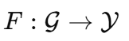
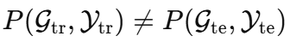
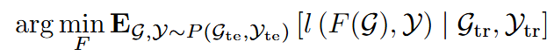
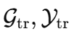
Problem Definition
What is Out-of-Distribution (OOD) Generalization?
Training vs. Test Distribution: In real-world scenarios, the test graphs often differ significantly from the training graphs in structure, size, or semantics.
Goal: Learn a model
that performs well on unseen test graphs
even when
Formal Objective:
under the constraint: only access to
Introduction
Methodology
Experiments
Conclusion
Notes:
我们介绍一些什么叫分布外泛化，就是我们想要达到一种效果，使得在测试集与训练集不是同一分布的情况下仍有很好的效果，
分布外泛化可以让我们更好的实现从数据集到真实世界的应用，
因为同分布假设在很多实际情况是不成立的，而且容易通过分布特征学习到一些虚假关联的捷径，

Slide 6
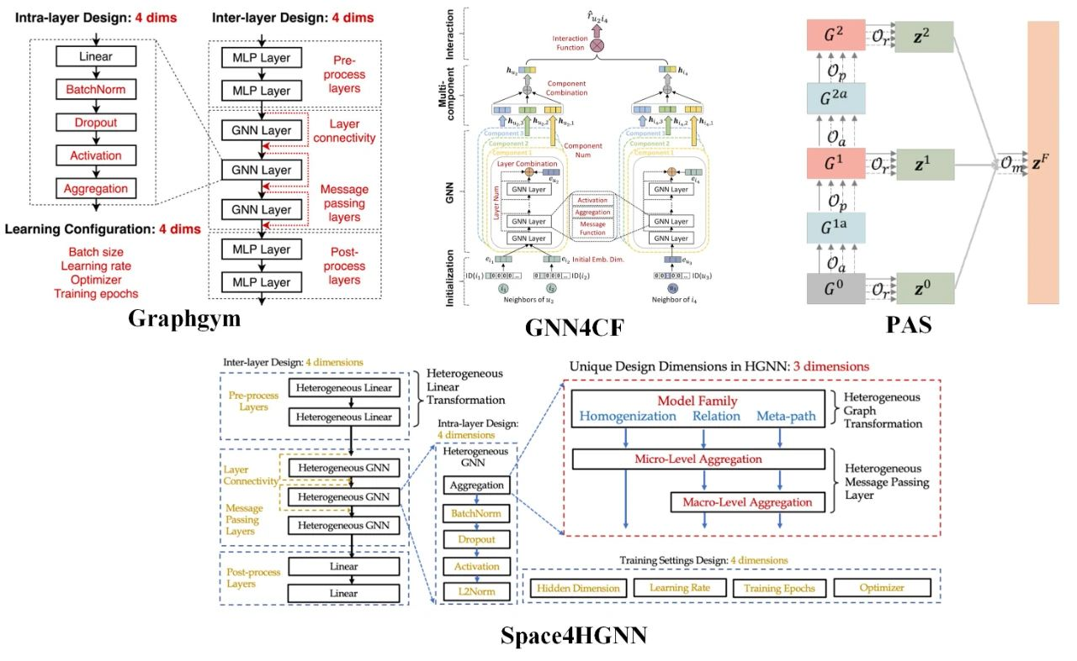
GraphNAS
What is Graph Neural Architecture Search (GraphNAS)?
Introduction
Methodology
Experiments
Conclusion
Notes:
什么是图神经网络架构搜索，他是神经网络架构搜索的一种，只不过搜索空间限制在了图神经网络中，
搜索空间主要分为两个部分，一个是不同层的连接方式， 另一个是网络层的操作算子，
通过架构搜索减少的人工设计网络架构的工作量，并且可以达到更好的效果

Slide 7
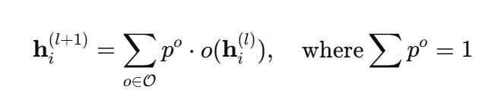
GraphNAS
What is GraphNAS?
Automates GNN architecture design by searching over candidate operations.
Early methods use black-box search in discrete space, suitable only for IID datasets.
Recent methods adopt differentiable architecture search with soft selection and weight sharing.
Performs well under distribution shifts by assigning different architectures to different graphs.
Key Formula:
Introduction
Methodology
Experiments
Conclusion
Notes:
早期的方法在离散空间中使用了一种叫做黑盒搜索的方法，比如使用强化学习或者一些经典的优化算法。
但这只有在训练数据和测试数据具有相同分布（我们称之为 IID）时才有效。
近期的方法使用可微分架构搜索。这意味着模型可以学习软选择操作，并在训练期间共享权重。
这有助于 GraphNAS 在分布发生变化的情况下更好地工作，因为它可以为不同的图分配不同的架构。

Slide 8
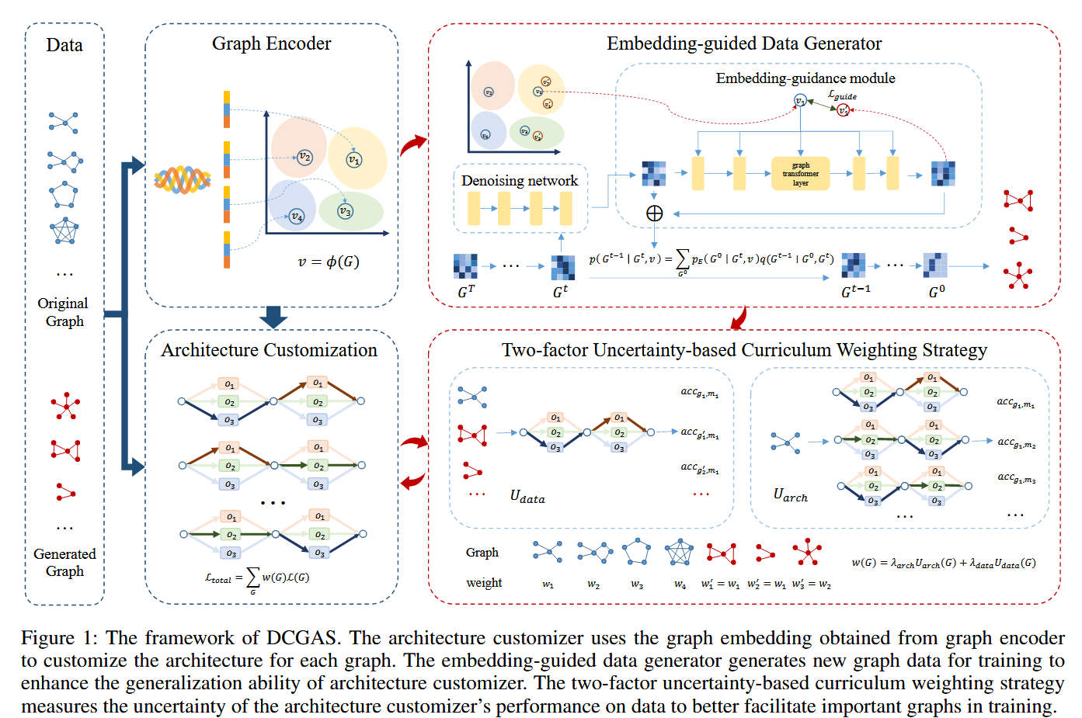
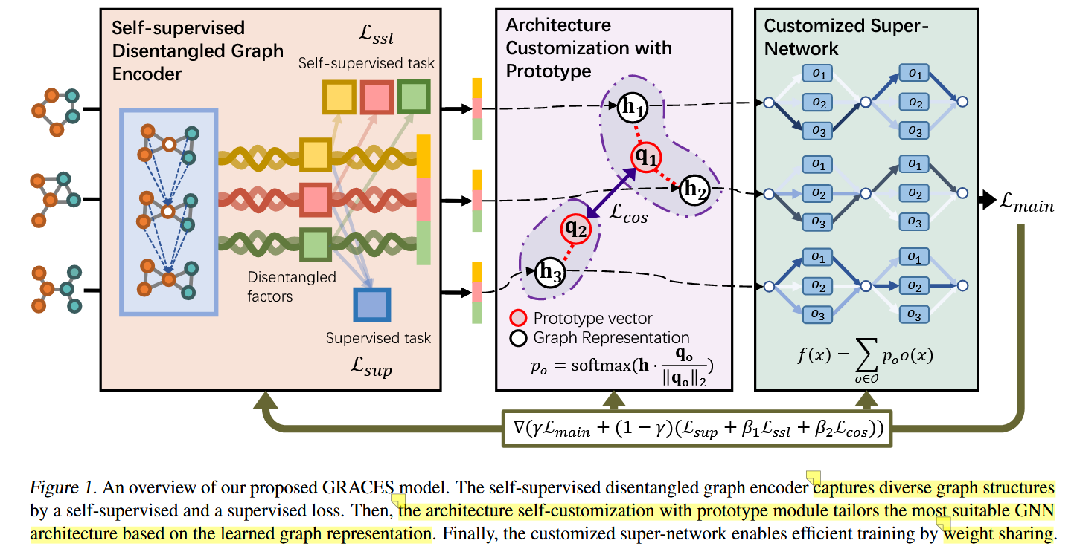
GraphNAS
Introduction
Methodology
Experiments
Conclusion
Notes:
这是最近一些可微分架构搜索

Slide 9
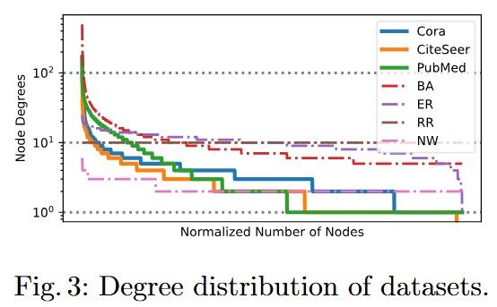
Limitations
Limitations of GraphNAS
Still relies on large-scale training data to learn graph-architecture mappings.
Struggles when training on sparse or single-graph datasets.
Assigns one architecture per graph — does not distinguish between nodes within a graph.
Ignores structural heterogeneity caused by long-tail node degree distributions.
Introduction
Methodology
Experiments
Conclusion
Notes:
尽管 GraphNAS 取得了一些进展，但它仍然存在一些重要的局限性。
首先，它仍然需要大量的训练数据来学习如何将图映射到良好的架构。这对于小型数据集或真实世界的数据集来说并不理想。
其次，在稀疏数据或单个图上进行训练时，它的表现不佳。
第三，GraphNAS 为每个图提供一种架构。但在图内部，并非所有节点都是相同的。它无法区分节点，即使它们的结构差异很大。
最后，它忽略了结构的异质性——尤其是我们在真实图中经常看到的长尾度分布。 在右侧，您可以看到来自不同数据集的节点度分布图。有些节点的度很高，但大多数节点只有少量连接。

Slide 10
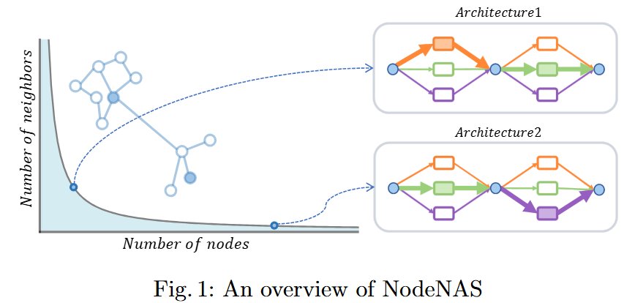
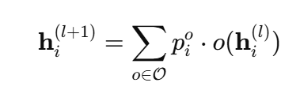
NodeNAS
NodeNAS: Node-Specific Architecture Search
Instead of applying the same aggregation method to all nodes, NodeNAS customizes GNN architectures per node.
Learns a unique probability vector for each node, selecting candidate operations dynamically.
Addresses node-level heterogeneity (e.g., long-tail degree distributions) across different graph types.
Facilitates OOD generalization by decoupling node degree patterns from global graph distribution.
Per-node aggregation formula:
Introduction
Methodology
Experiments
Conclusion
Notes:
那么，我们如何解决刚才提到的问题呢？
答案就是我们提出的方法：节点特化的架构搜索 。
NodeNAS 不会对所有节点应用相同的聚合方法，而是为每个节点提供其专属的定制架构。
具体来说，它会为每个节点学习一个唯一的概率向量。该向量用于动态选择不同的候选操作。
这有助于我们处理长尾度分布。 NodeNAS 适用于不同类型的图，并通过将节点级模式与图的全局结构分离，帮助提升 OOD 泛化能力。
在右侧，您可以看到两个节点如何根据其结构获得不同的架构。

Slide 11
2
Methodology

Slide 12
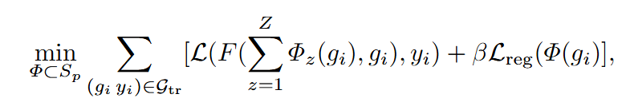
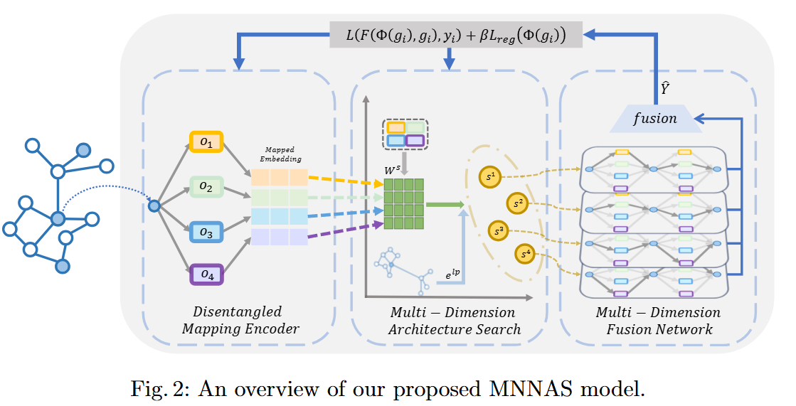
Framework
Multi-dim Node-Specific Graph Neural Architecture Search (MNNAS)
Introduction
Methodology
Experiments
Conclusion
Notes:
这是我们模型的整体框架。
它包含三个部分：首先，编码器将节点特征与全局上下文进行映射。
其次，架构搜索学习每个节点的最佳操作。
第三，融合网络将所有输出组合成最终的节点表示。
整个模型采用端到端训练，并支持节点级自定义。

Slide 13
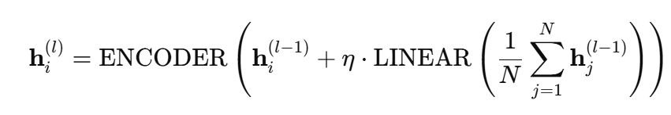
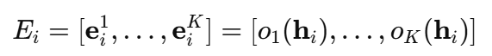
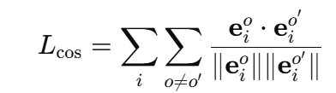
Encoder
Disentangled Mapping Encoder
Injects global context by combining local features with graph-wide averages:
Maps each candidate operation to a learnable node-specific embedding:
Shared mapping across all search dimensions (S-Dims) ensures efficiency.
Applies cosine regularization to preserve diversity:
Introduction
Methodology
Experiments
Conclusion
Notes:
此模块是解缠映射编码器。
它通过将局部特征与所有节点特征的平均值相结合来添加全局上下文。
然后，它将每个操作映射到可学习的节点特定嵌入。
相同的映射在所有维度上共享，从而节省计算量。
最后，我们使用余弦正则化来保持操作嵌入的多样性。

Slide 14
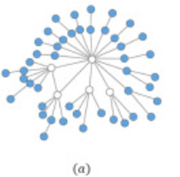
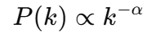
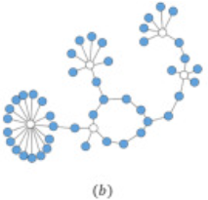
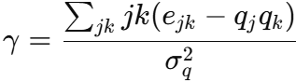
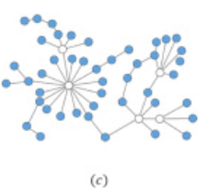
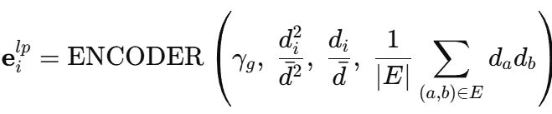
Architecture Search
Multi-Dim Architecture: Link Pattern Encoder
Motivation: Generalizing to OOD graphs requires modeling both node-level structure and global graph properties.
Power Law Distribution:
High-degree hubs vs. long-tail nodes require different aggregation strategies.
Assortativity: Measures how similar connected nodes are in degree:
Encoder Input:
Introduction
Methodology
Experiments
Conclusion
Notes:
这部分是链接模式编码器，它帮助模型理解节点级结构和全局图模式。
许多图遵循幂律分布，其中少数节点有很多边，而大多数节点的边很少。
这些节点需要不同的聚合策略。 我们还测量了同配性，它告诉我们连接节点在度方面的相似程度。
所有这些统计数据都用作编码器的输入。
这种设计有助于将节点身份与图类型分离，这对于 OOD 泛化至关重要。

Slide 15
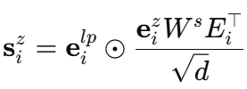
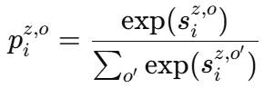
Architecture Search
Multi-Dim Architecture: Adaptive Aggregation Attention
For each node i in S-Dim, compute operation preferences:
Use softmax to get probabilities over candidate operations:
Attention mechanism aligns operation selection with topological context, guided by link pattern vector.
Introduction
Methodology
Experiments
Conclusion
Notes:
这部分使用自适应注意力机制来决定每个节点应该优先选择哪些操作。
对于每个维度中的每个节点，我们计算一个分数，并应用softmax函数来计算操作的概率。
注意力机制由节点的链接模式引导，因此操作与其拓扑上下文相匹配。
它还能很好地泛化到不同的图分布中

Slide 16
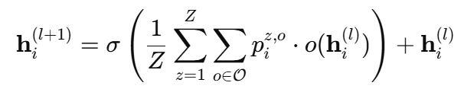
Fusion Network
Multi-Dimension Fusion Network
Aggregates node-specific architectures across all search dimensions (S-Dims) to build final node representation.
Fusion Formula:
Uses residual connection to preserve identity and reduce overfitting.
Thanks to shared embedding mapping avoids redundant operation computation.
No architecture discretization or retraining — supports end-to-end weight sharing.
Introduction
Methodology
Experiments
Conclusion
Notes:
最后，我们使用融合网络将所有搜索维度上特定于节点的架构组合成最终的节点表示。
我们应用残差连接来保留原始特征并避免过拟合。
由于我们跨维度共享嵌入，因此效率更高，并避免了冗余计算。 无需离散化或重新训练

Slide 17
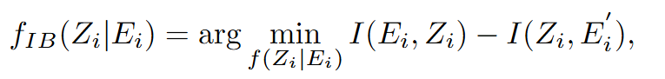
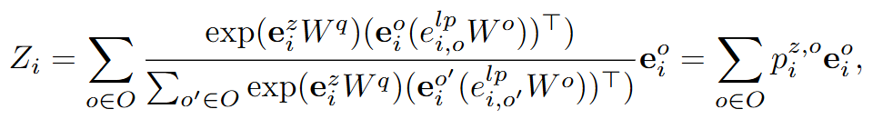
Theoretical Insights
Theoretical Analysis Through Information Bottleneck Theory
It aims to find the most concise and effective data representation, that is, to retain the most valuable information by sacrificing some irrelevant information.
Introduction
Methodology
Experiments
Conclusion
Notes:
信息瓶颈理论的本质就是：最大化Z和Y的互信息，尽量减少X和Z的互信息
旨在寻找最简洁有效的数据表示，即通过牺牲部分无关信息来保留最有价值的信息。

Slide 18
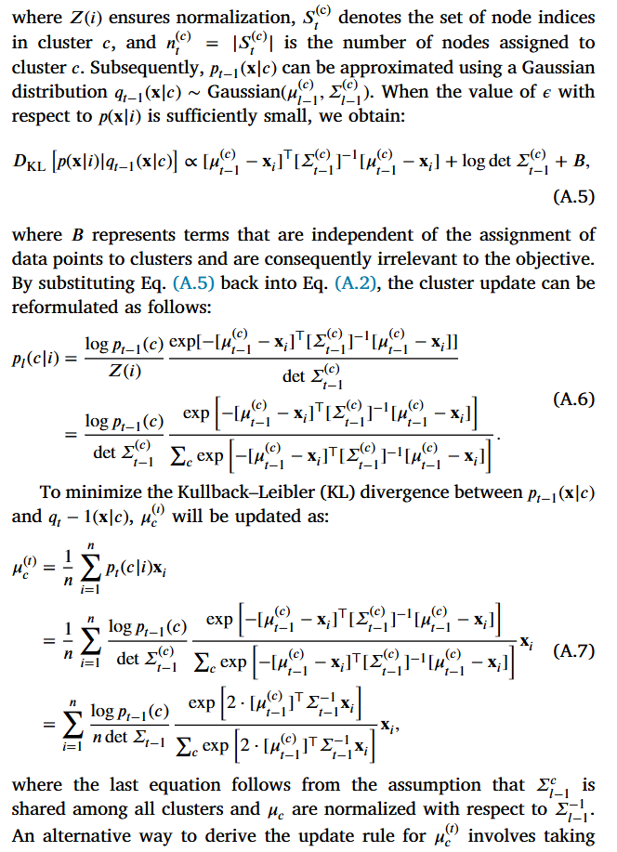
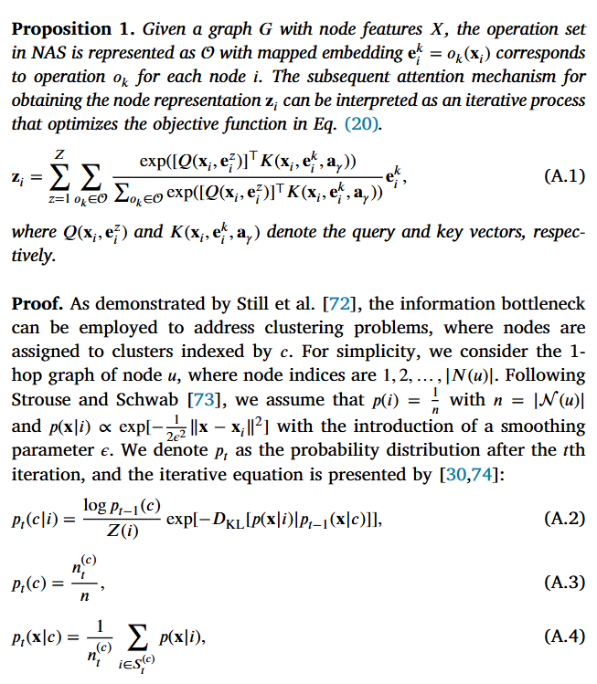
Theoretical Insights
Introduction
Methodology
Experiments
Conclusion

Slide 19
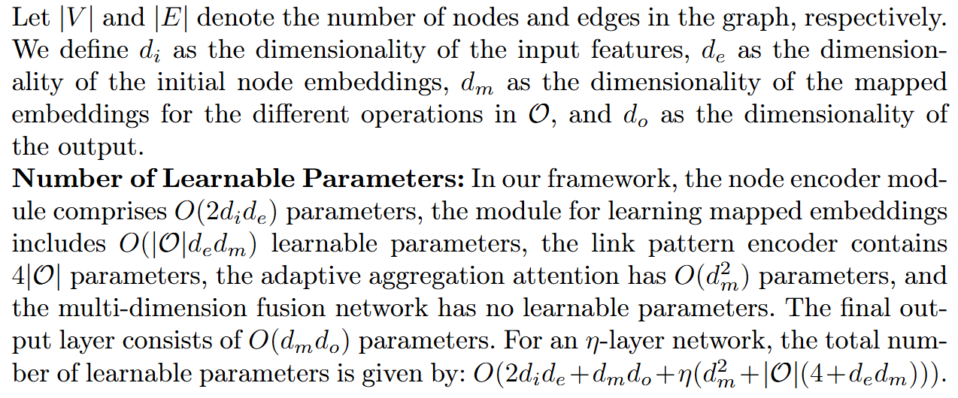
Complexity Analysis
Introduction
Methodology
Experiments
Conclusion

Slide 20
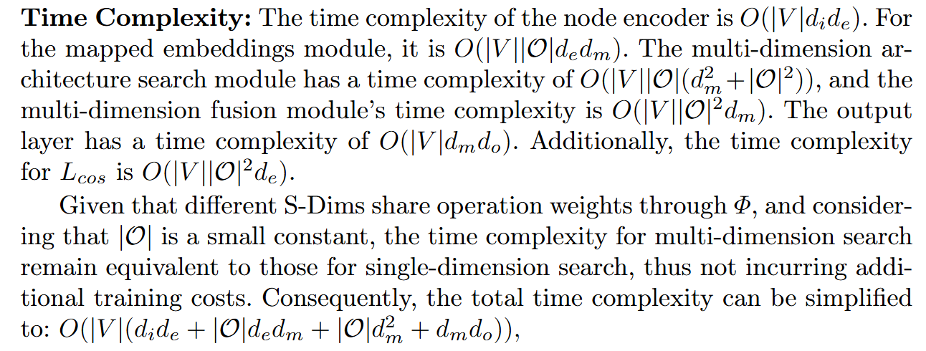
Complexity Analysis
Introduction
Methodology
Experiments
Conclusion

Slide 21
3
Experiments

Slide 22
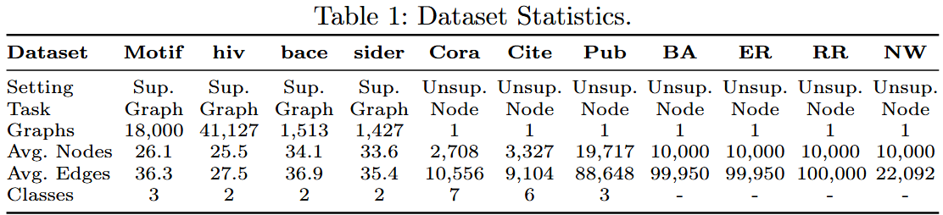
Setting
Experimental Setup
Goal: Evaluate MNNAS under distribution shifts across
➤ Supervised graph classification ➤ Unsupervised community detection ➤ Inverse graph partitioning
Baselines
Hand-designed GNNs: GCN, GAT, GIN, GraphSAGE, GraphConv, GAP, ClusterNet, ASAP, DIR, PNA, GSAT
NAS-based Methods: DARTS, GraphNAS, PAS, GASSO, GRACES, DCGAS (SOTA)
Introduction
Methodology
Experiments
Conclusion

Slide 23
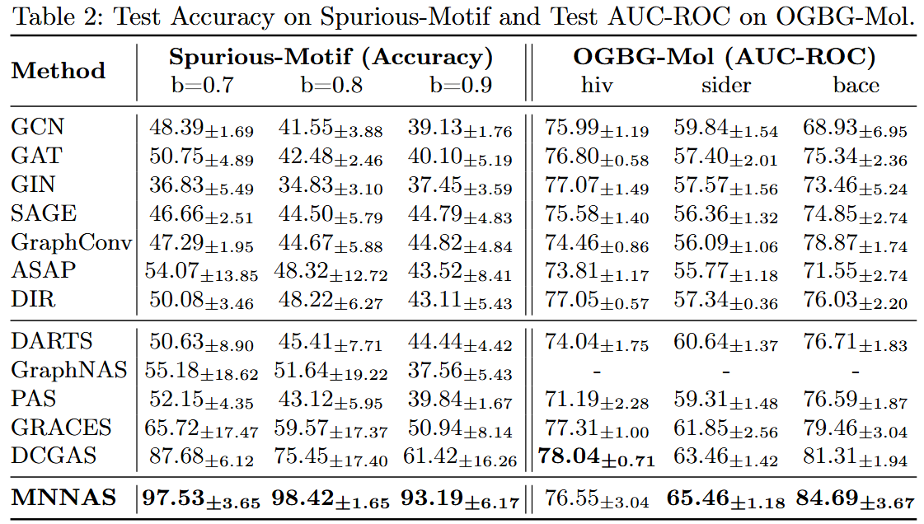
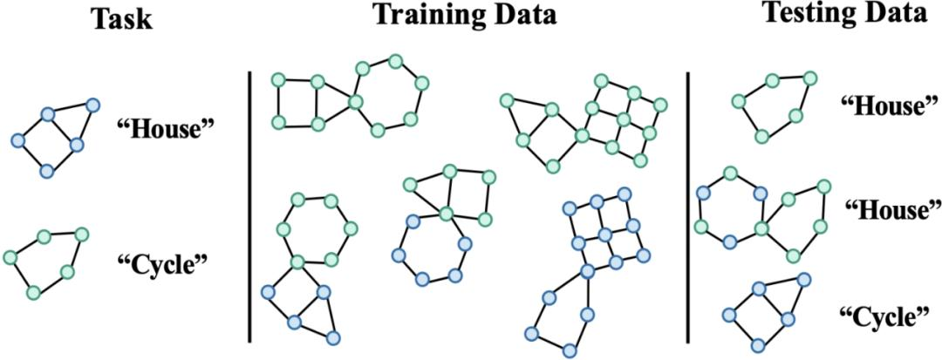
Graph Classification
Introduction
Methodology
Experiments
Conclusion

Slide 24
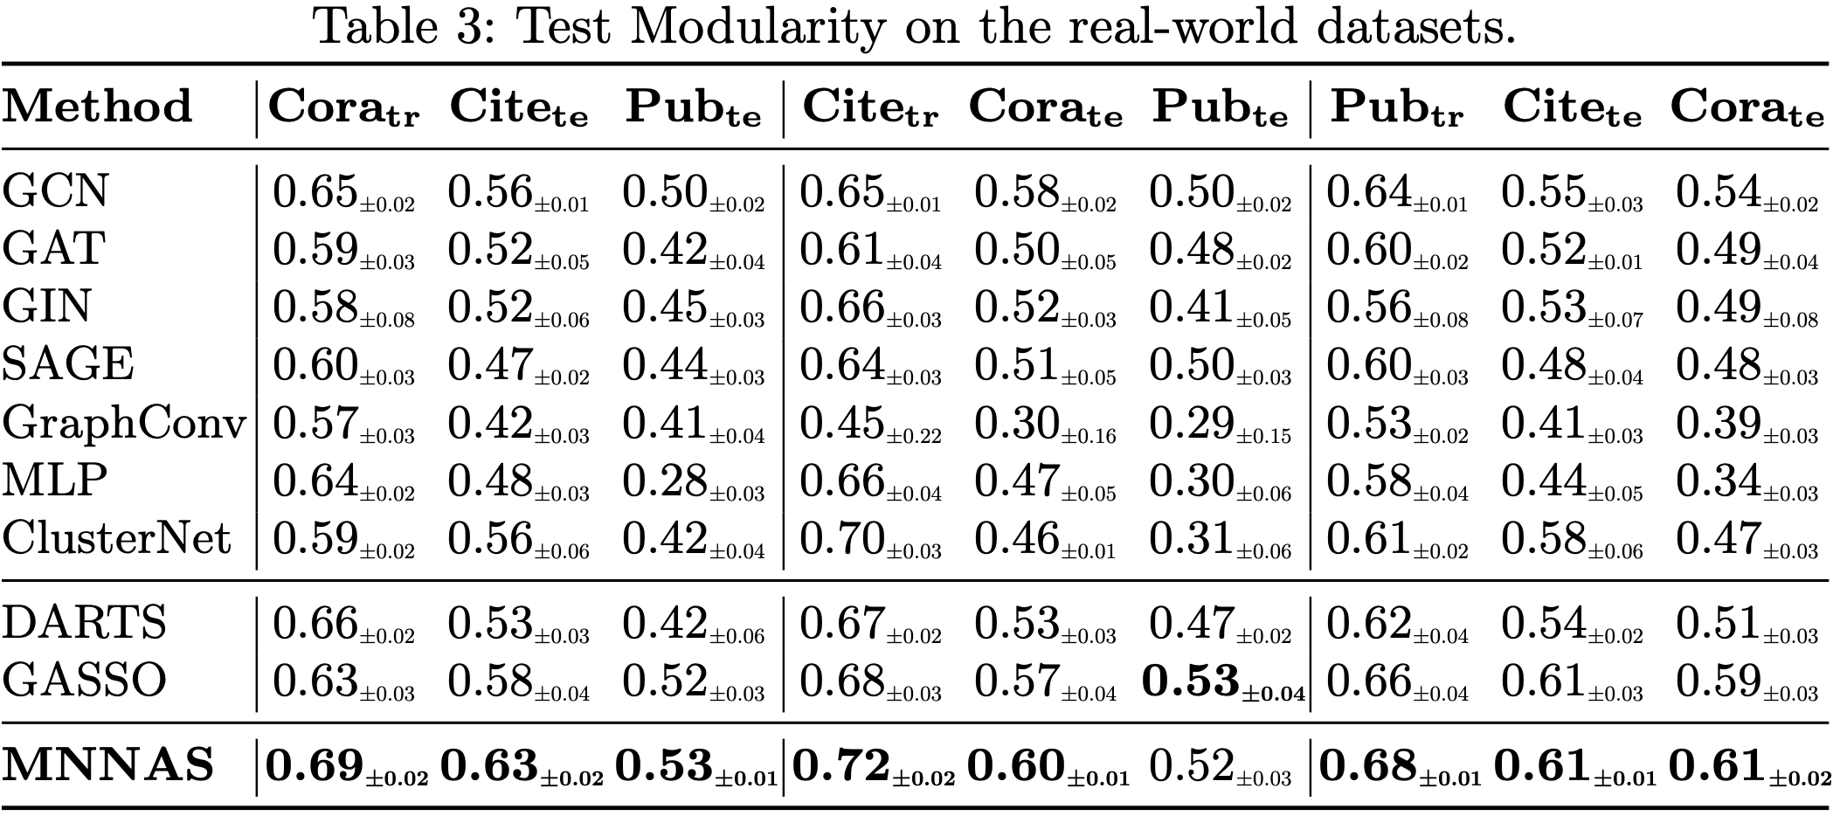
Community Detection
Introduction
Methodology
Experiments
Conclusion
Notes:
We evaluate test modularity on multiple real-world datasets. MNNAS consistently outperforms both GNN-based and NAS-based baselines. This confirms its effectiveness in unsupervised structure discovery.

Slide 25
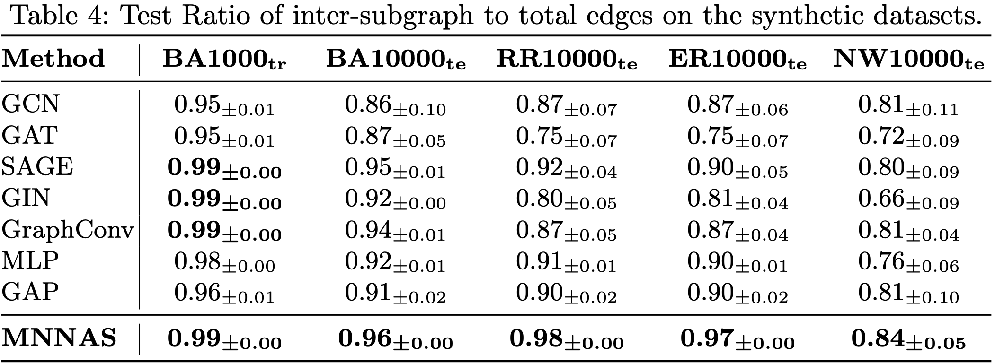
Inverse Graph Partition
Introduction
Methodology
Experiments
Conclusion

Slide 26
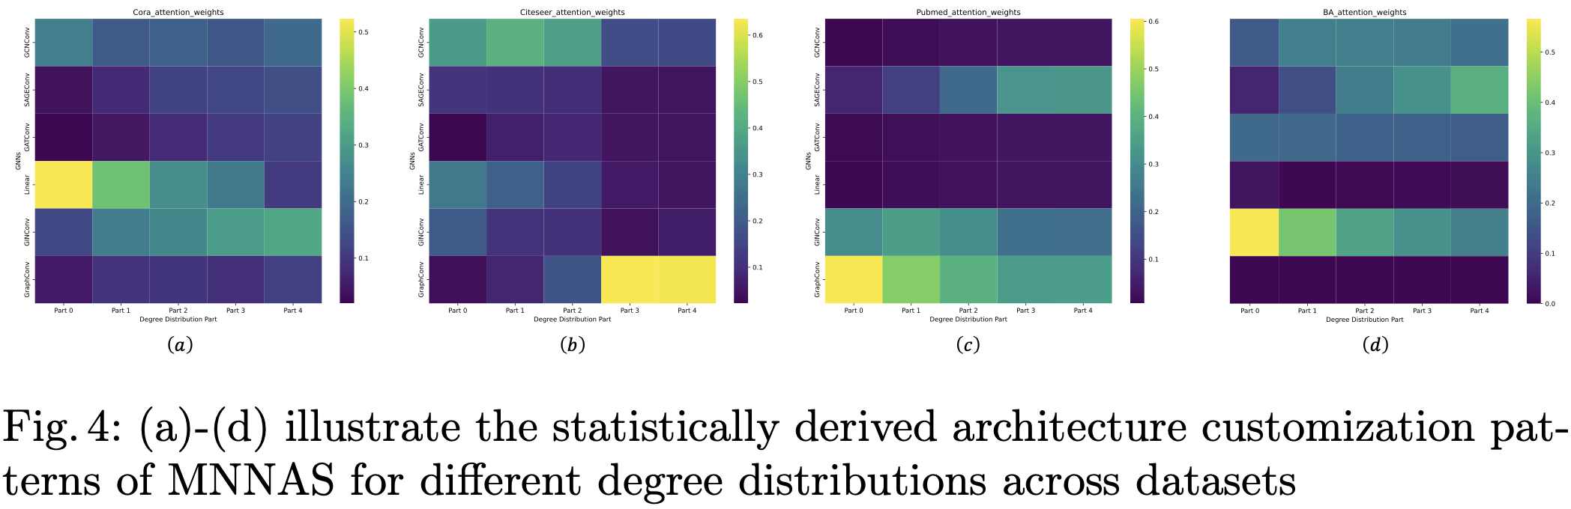
Interpretability
Introduction
Methodology
Experiments
Conclusion

Slide 27
3
Conclusion

Slide 28
Conclusion
MNNAS introduces node-specific architecture search, allowing each node to select its own aggregation strategy — adapting flexibly to structural diversity within and across graphs.
Incorporates adaptive aggregation attention, disentangling power-law degree and assortativity patterns to guide multi-dimensional architecture search.
Achieves strong OOD generalization, even under limited or single-graph training — a first in GraphNAS literature.
Validated across supervised and unsupervised tasks, demonstrating consistent improvements over state-of-the-art GNNs and NAS methods on challenging distribution-shift benchmarks.
Introduction
Methodology
Experiments
Conclusion

Slide 29
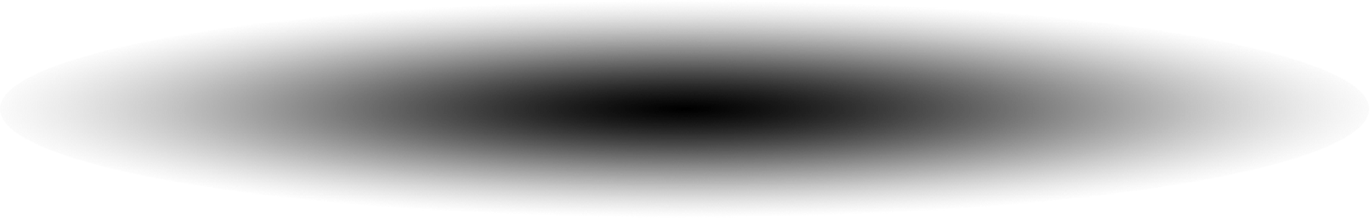
Thank you!
2252090 王麒懿, 2250420 陈君, 2250758 林继申
2025年6月20日

